Slide 1
Biodiversity Project
Atid Baharanchi Abbassi

Slide 2
Data Summary
This data frame contains information regarding the conservation statues of 5541 unique species in US National Parks.
There are four conservation status and seven broad species categories.
Table below shows the description of the data-frame.
 | category | Scientific name | Common names | Conservation status
count | 5824 | 5824 | 5824 | 191
unique | 7 | 5541 | 5504 | 4
top | Vascular Plant | Holcus lanatus | Brachythecium Moss | Species of Concern
freq | 4470 | 3 |  | 161

Slide 3
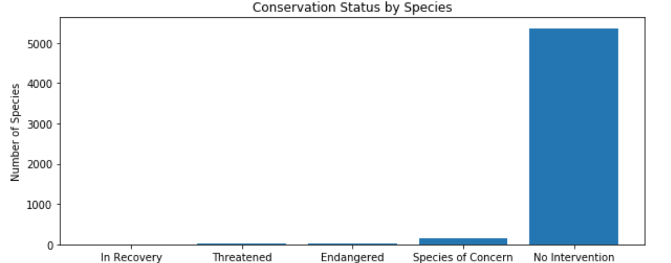
Data Analysis
Among 5,543 species, there are 180 ones that are either endangered or require some kind of attention. These species are considered unprotected species.
conservation status | Scientific name
Endangered | 15
In Recovery | 4
No Intervention | 5363
Species of Concern | 151
Threatened | 10

Slide 4
Protection percentage by categories
Mammals received more protection relative to Birds showing the risk of extinction.
Chi squared test shows that, at 95% level of confidence, there is no significant statistical difference between protection percentages between these two categories.
The p-value of the test is 0.68 not being able to reject null hypothesis.
When we test the difference between Mammal and Reptile, the p-value is 0.03 reflecting a statistical difference between the protection percentages.
category | Not protected | protected | Percent protected
Amphibian | 72 | 7 | 0.088608
Bird | 413 | 75 | 0.153689
Fish | 115 | 11 | 0.087302
Mammal | 146 | 30 | 0.170455
Nonvascular Plant | 328 | 5 | 0.015015
Reptile | 73 | 5 | 0.064103
Vascular Plant | 4216 | 46 | 0.010793

Slide 5
Recommendation for Endangered Species
Based on the significance calculation, species in Reptile category receive less protection. It is being recommended that the National park adds more protections for the specious in this category .

Slide 6
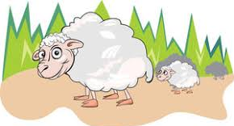
National Park’s Sheep Study

Slide 7
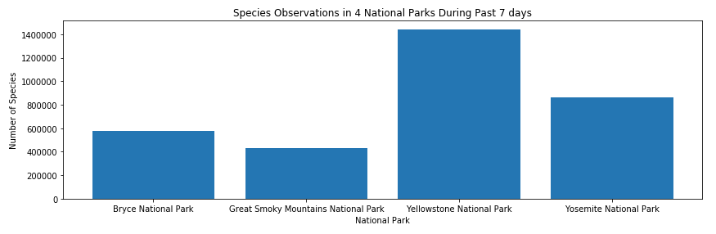
Data Summary
Some scientists are studying the number of sheep sightings at different national parks.
Based on data received from four national parks, total number of 23296 sightings of different species was recorded at several national parks for the past seven days
Park Name | observations
Bryce National Park | 576025
Great Smoky Mountains National Park | 431820
Yellowstone National Park | 1443562
Yosemite National Park | 863332

Slide 8
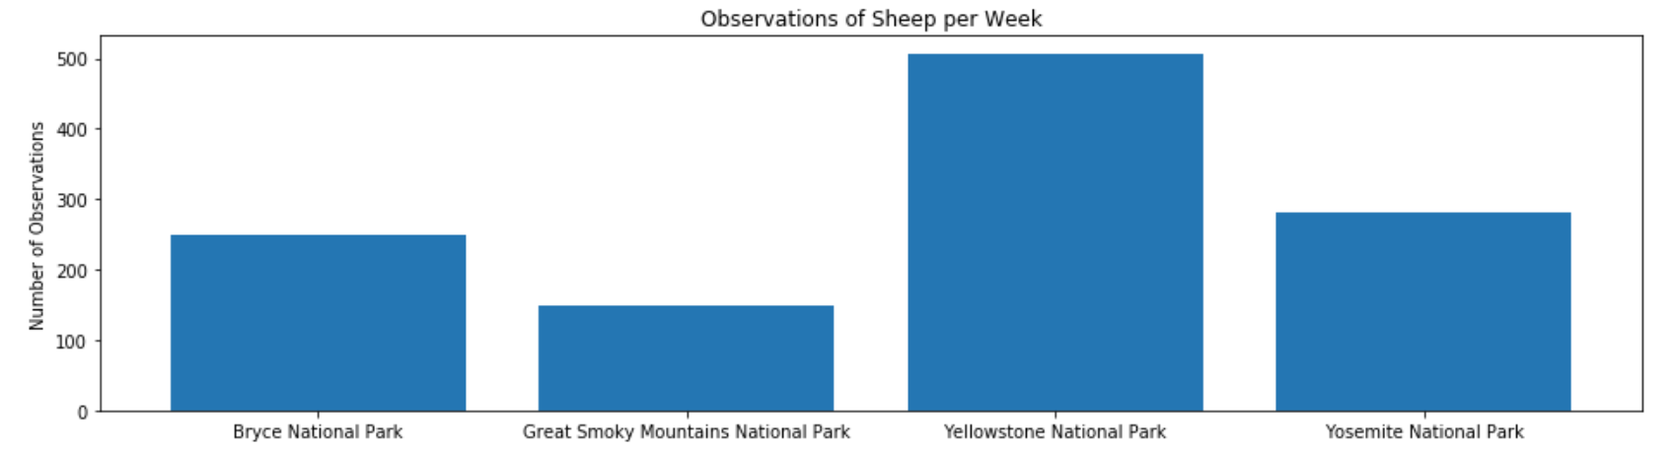
Sheep Study
Some scientists are studying the number of sheep sightings at different national parks.
Table below shows total number of sheep observed in each of the four parks over the past seven days
Park Name | observations
Bryce National Park | 250
Great Smoky Mountains National Park | 149
Yellowstone National Park | 507
Yosemite National Park | 282

Slide 9
Foot and mouth disease study on Sheep in Yellowstone park
Current Status:
15 percent of sheep at Bryce National Park have foot and mouth disease
Program Study:
Objective:
Park rangers at Yellowstone National Park have been running a program to reduce the rate of foot and mouth disease at that park.
Goal:
5% point reductions in the number of infected sheep

Slide 10
Sample Size Selection
For 90% level of significance for the moth and feet disease test, scientists need to take a sample of at least 510 sheep in Yellowstone national park.
Based on the historical data on sheep observation in each park per week, approximately 2 weeks of sampling is required in Yellowstone park.

